Slide 1

Are you ready for Prom?​
​
See the Prom outfits we have available to purchase​
£10​
All proceeds go to the Friends of Chosen Hill School ​
Speak to staff in the hub for details​
These are pre-loved items, some may need a little mend but all easily done​

Slide 2
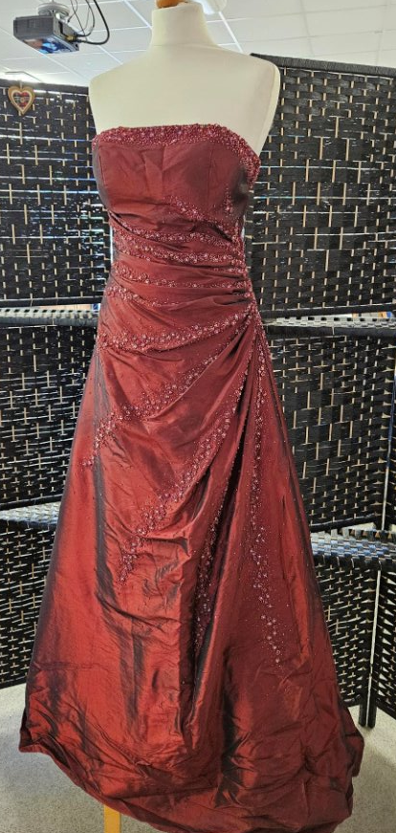
Dynasty​
Deep Red​
Beading work​
Full Skirt & Full Length​
Size 10​

Slide 3
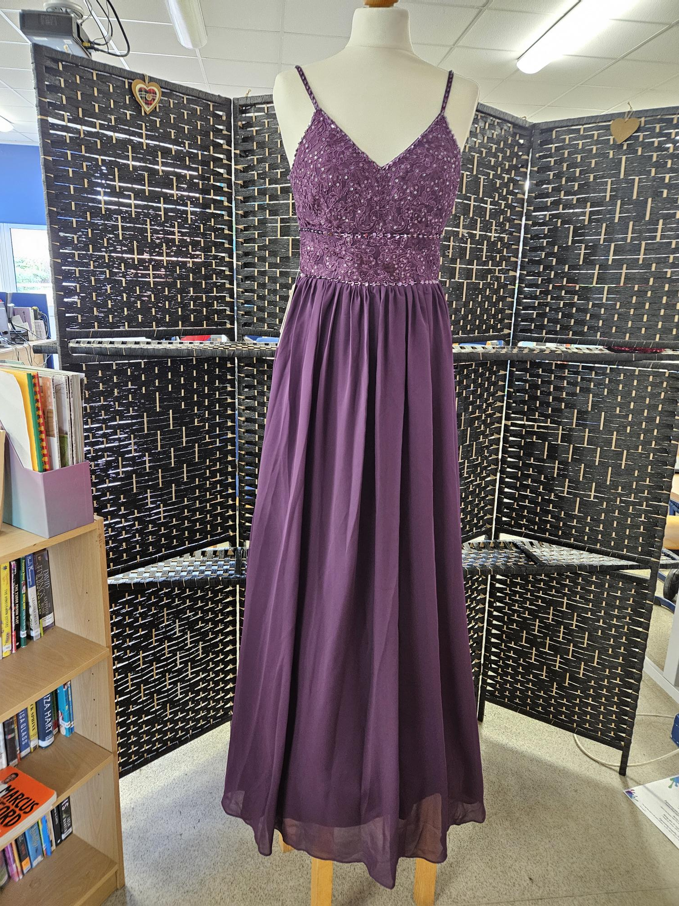
JJ House​
Purple/Plum​
Full length​
Embroidery & Beading detail to bust​
Brand new with tag​
Size 8

Slide 4
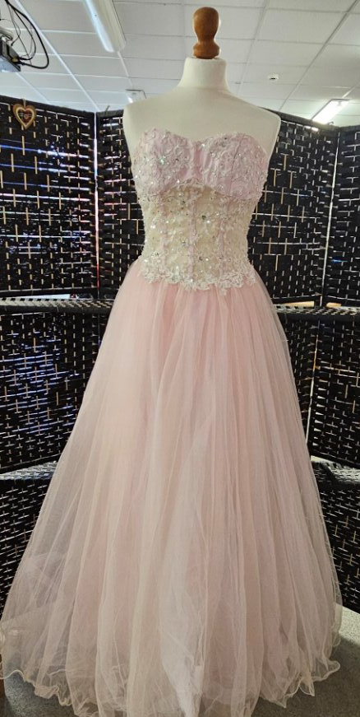
Bespoke made​
Boned, transparent lace bodice​
Full netted Skirt​
Size 8

Slide 5
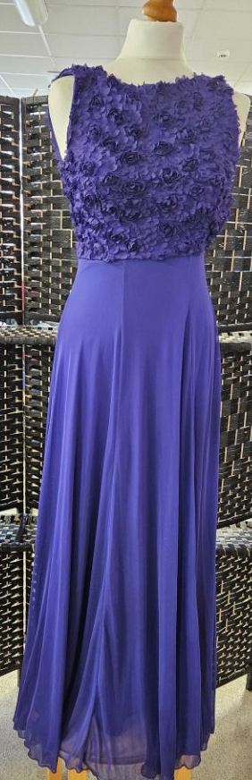
Purple​
Full Length, sleevless​
Size 8

Slide 6
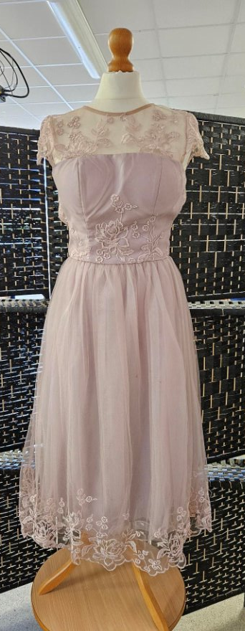
Chi Chi​
Dusty Pink, embroidery to trim and neckline​
Cap sleeves​
¾ Length

Slide 7
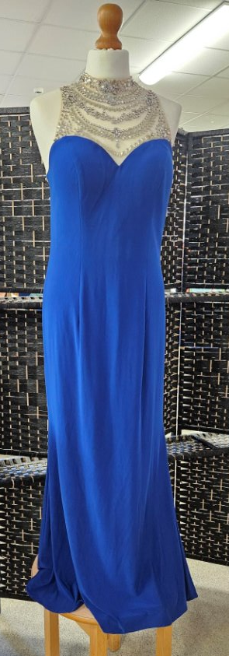
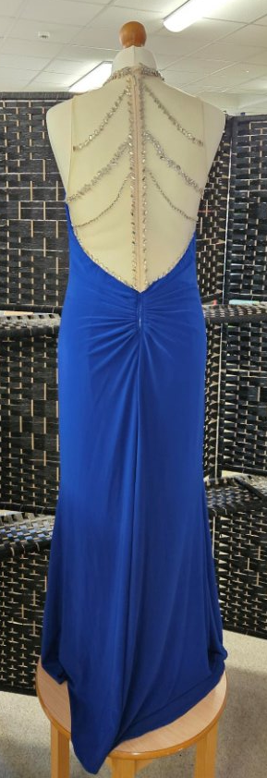
Angel Forever​
Royal blue, beading work to neckline & back​
Large​
Full Length & fishtail train​

Slide 8
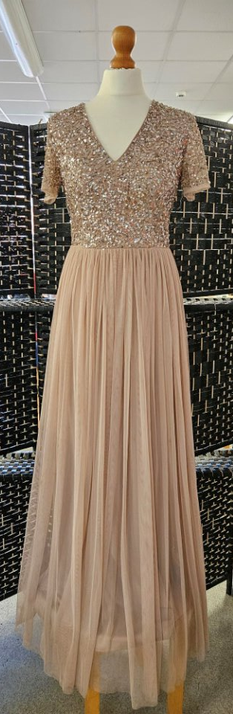
Maya Deluxe​
Latte colour​
Full length skirt​
Short sleeves, sequin detail to top.​
Size 8

Slide 9
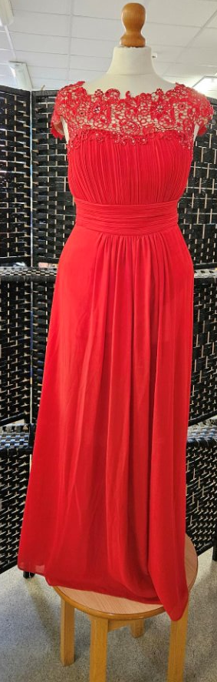
Ever Pretty​
Red, full length skirt​
Lace detail to neckline​
Size 10

Slide 10
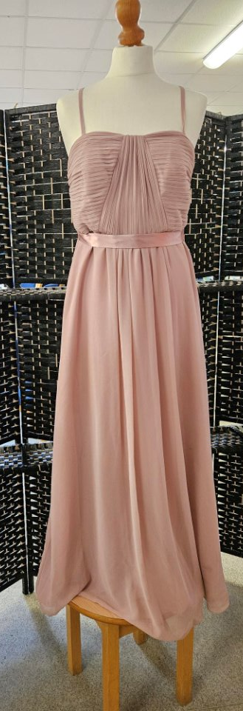
Debut​
Dusty Rose​
Full Length​
Size 12

Slide 11
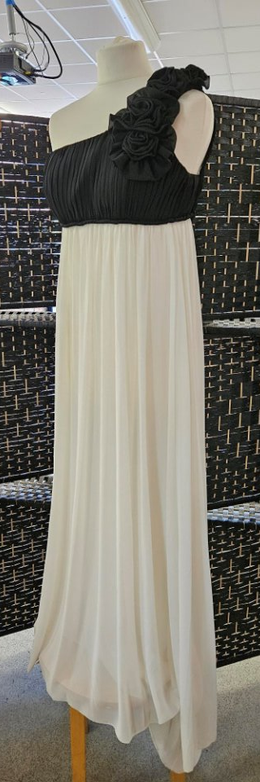
Empire line dress​
White full length skirt, black bust area with one shoulder strap.​
Size 6

Slide 12
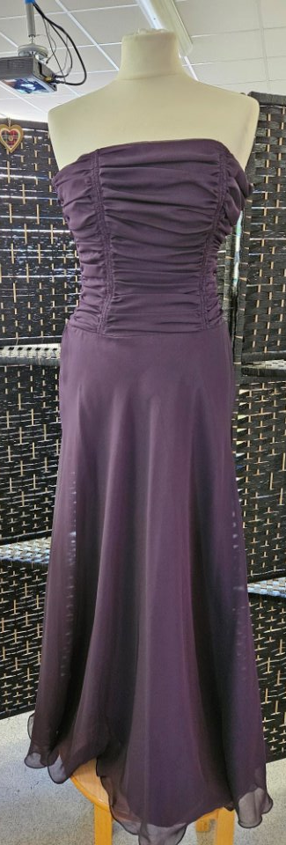
Brand new with tags.​
Wallis​
Strapless, ¾ length, plum​
Size 10

Slide 13
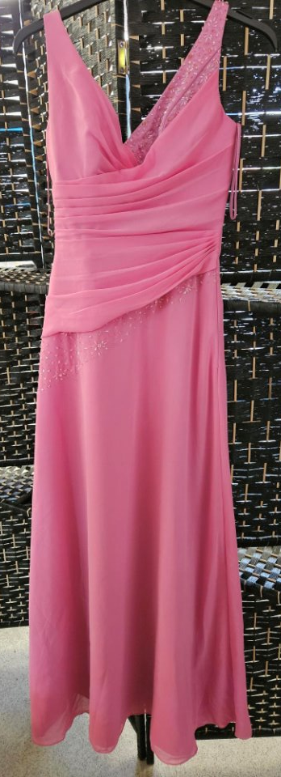
2 available​
Pink, full length, beading to 1 shoulder and waist.​
Size 4 & size 6

Slide 14
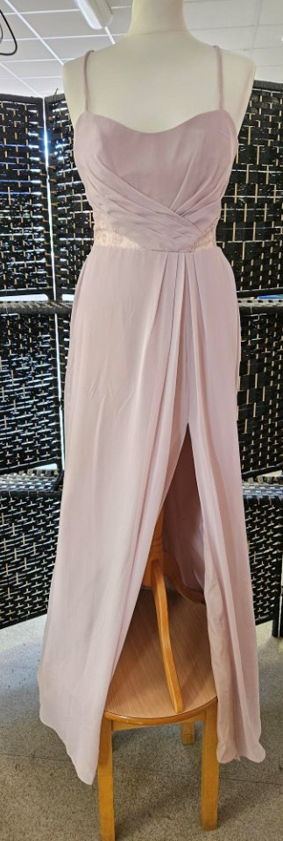
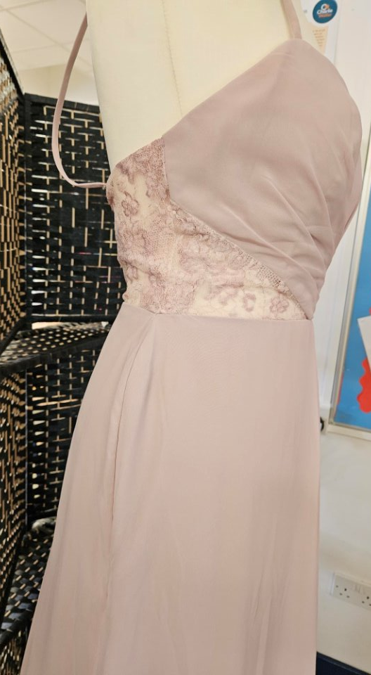
Black shift dress​
Beading & Embroidery work to waist & shoulders​
¾ length​
Size 12

Slide 15
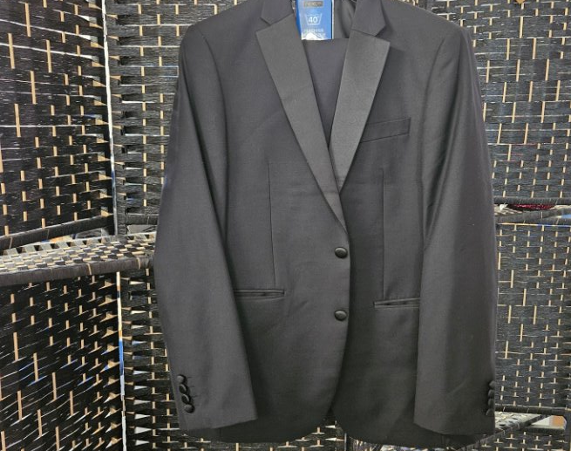
Black Tuxedo Suit​
Blazer = 40” Reg​
Trousers = 34” Reg

Slide 16
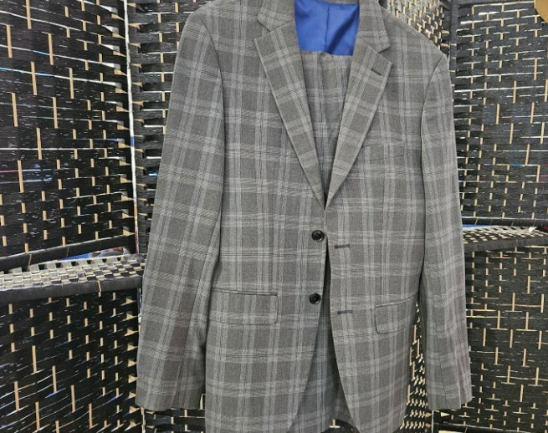
Grey check suit​
Blazer = 34” Reg, slim fit​
Trousers = 30” Short

Slide 17
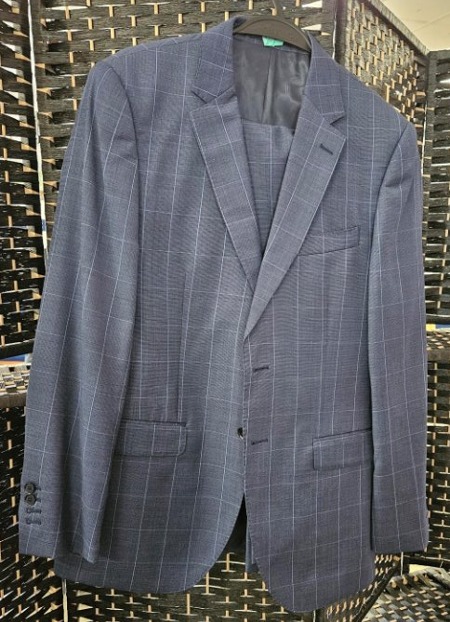
Hawes & Curtis​
Blazer = 40” Reg Slim​
Trousers = 32” Reg Slim

Slide 18
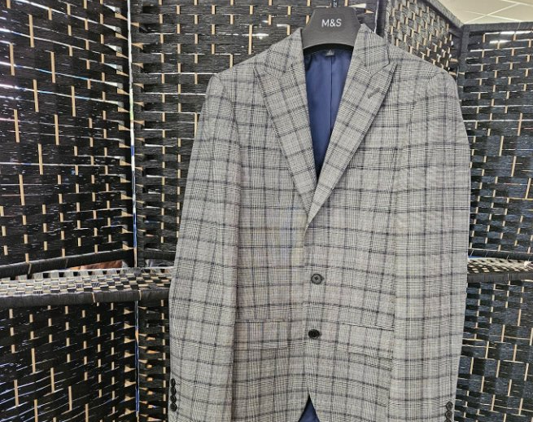
Marks & Spencers​
Light Grey check​
Jacket only​
34” Reg

Slide 19
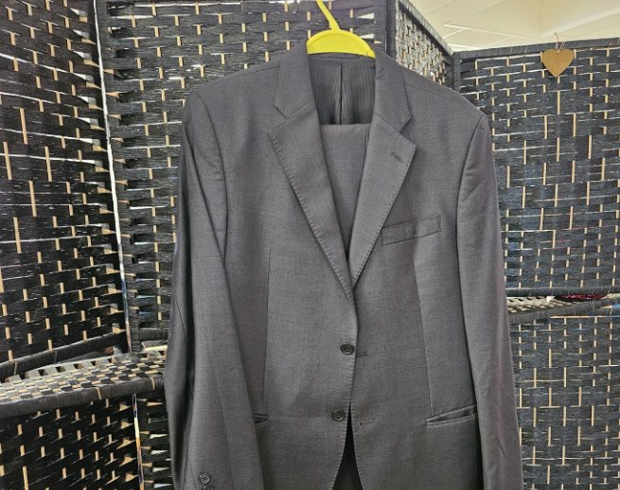
Lunificio Suit​
Jacket = 40” Reg​
Trousers = 34”Reg​

Slide 20
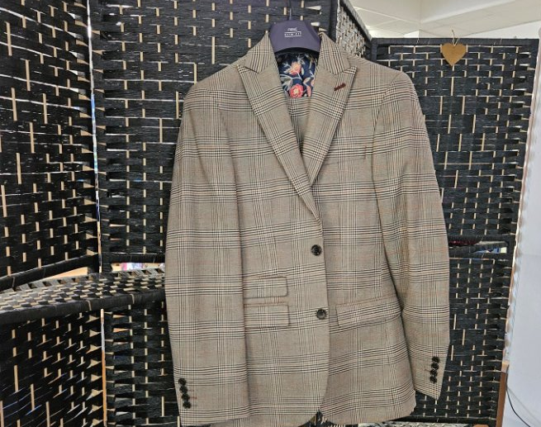
Marks & Spencers​
Blazer = 34” Reg Slim​
Trousers = 30” Short

