Slide 1

Are you ready for Prom?
See the Prom outfits we have available to purchase
£10
All proceeds go to the Friends of Chosen Hill School
Speak to staff in the hub for details
These are pre-loved items, some may need a little mend but all easily done

Slide 2
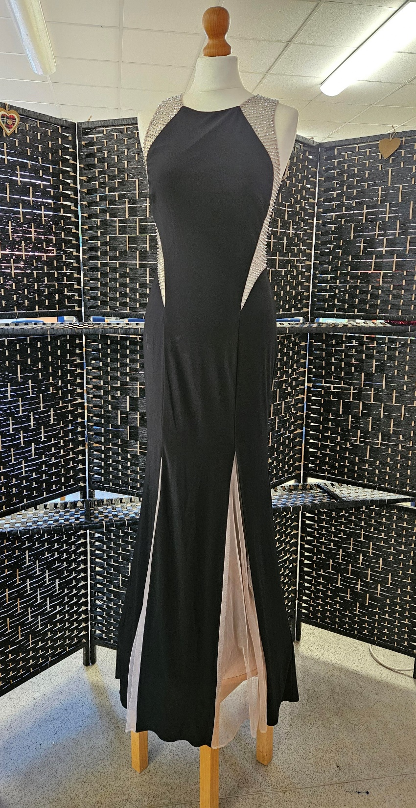
Xscape Dress.
Black with nude insert & sparkle detail to shoulder area, size 8
Slight damage to train

Slide 3
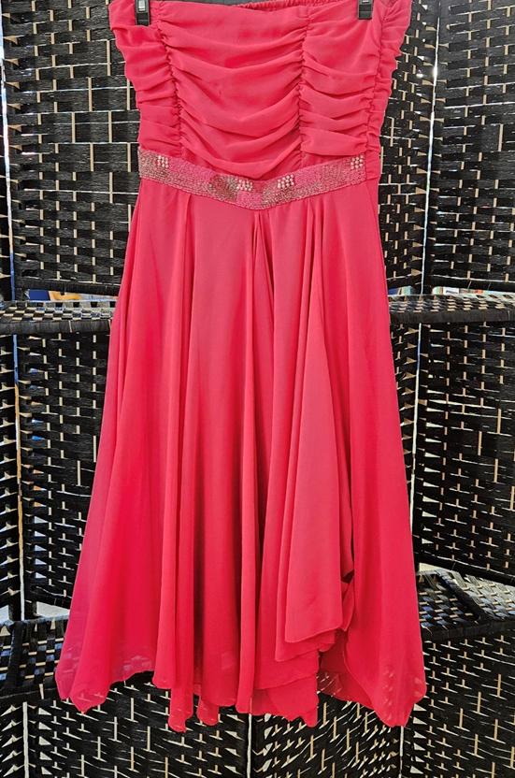

Charmed.
Pink, short dress, sparkle detail to waist. Age 16.

Slide 4
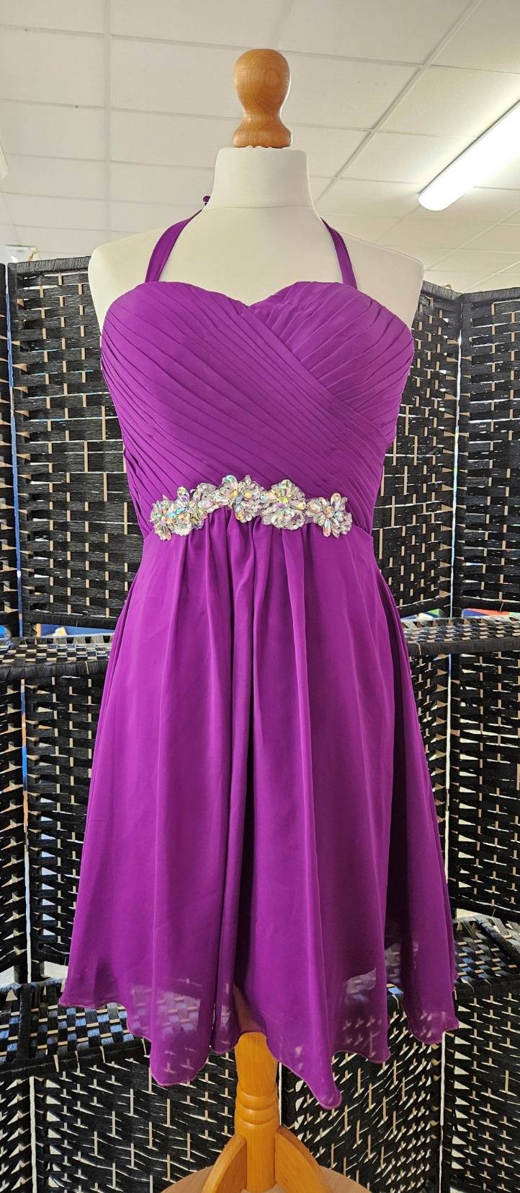
Purple, short, lace up back. Size 14

Slide 5
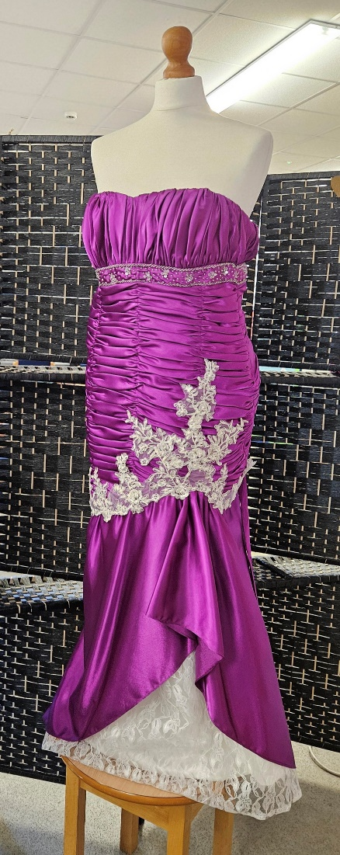
Purple & White lace detail. Lace up back. Size 14/16

Slide 6
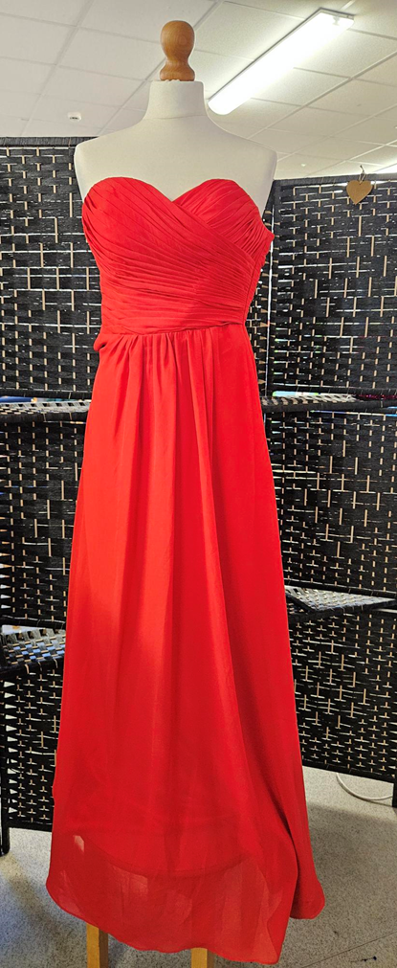
Red strapless, internal bra. Size 6.

Slide 7
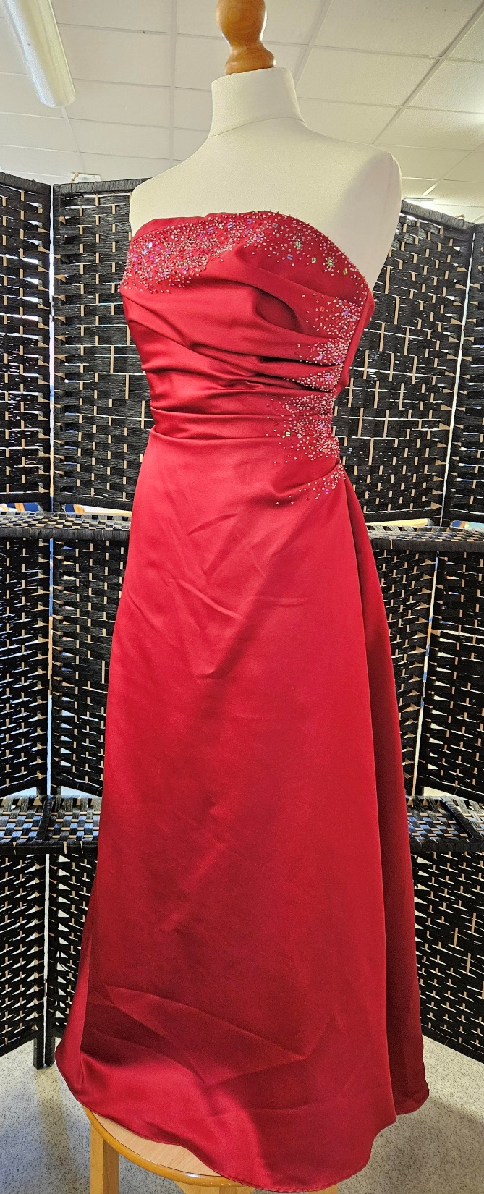
Alfred Angelo.
Deep red with sparkle acent. Strapless, size 8

Slide 8
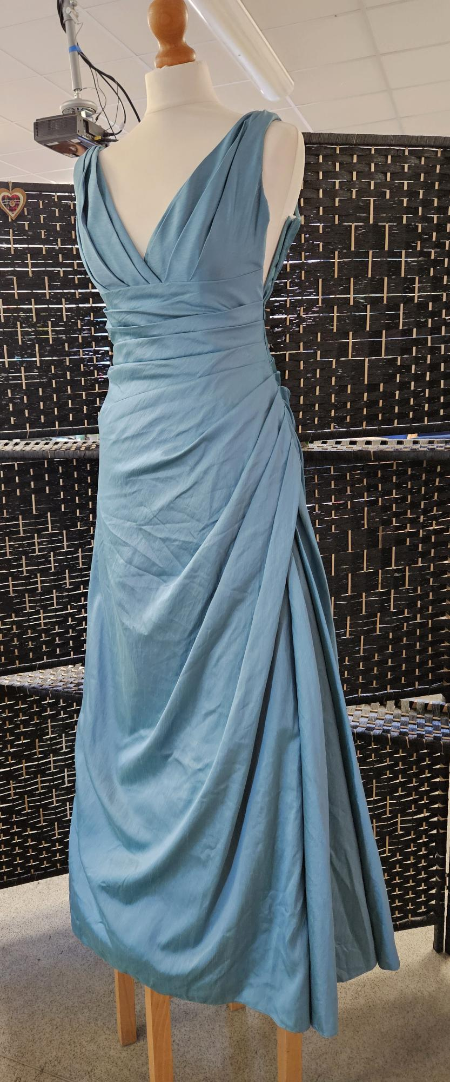
2 of these dresses available
Teal, A-Line, size 8

Slide 9
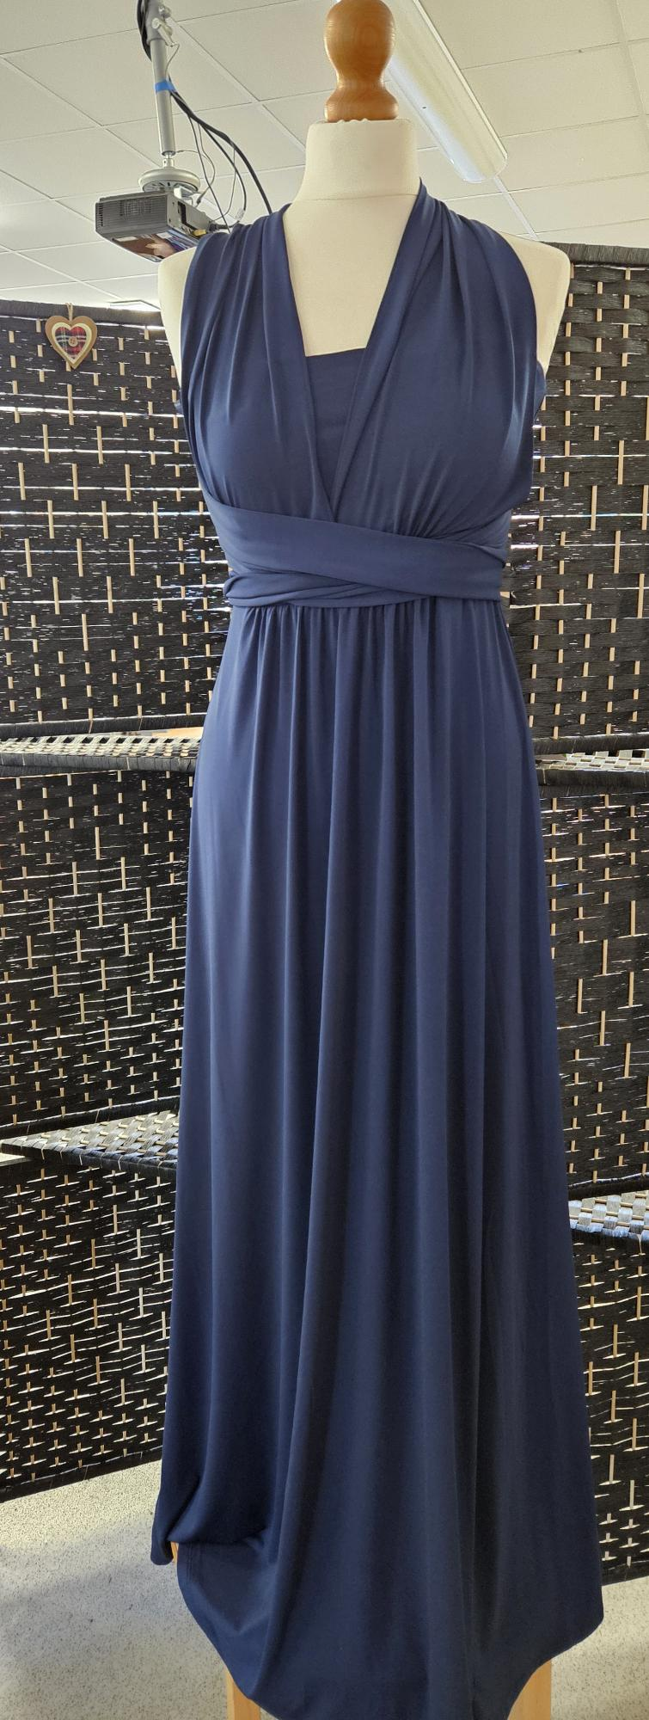
Navy Blue Infinity Dress – select the neckline you want.
Brand new with tags
Size 10

Slide 10
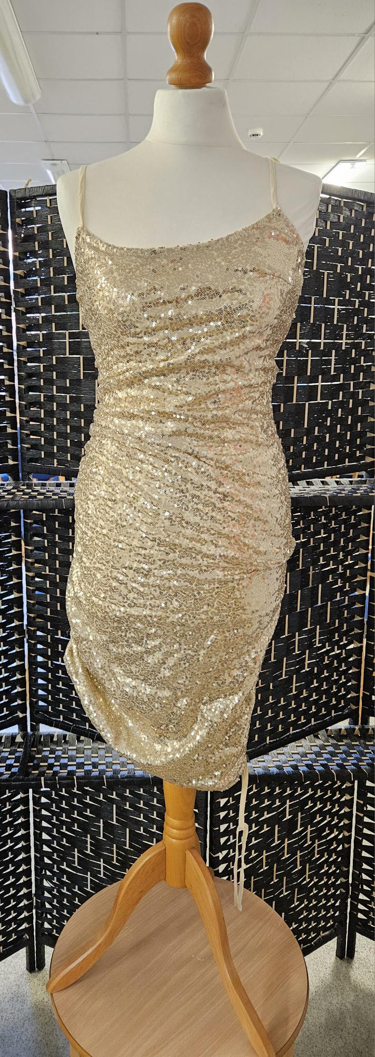
Pretty Little Thing.
Gold Sequin, short length with side adjustable length.
Size 10

Slide 11
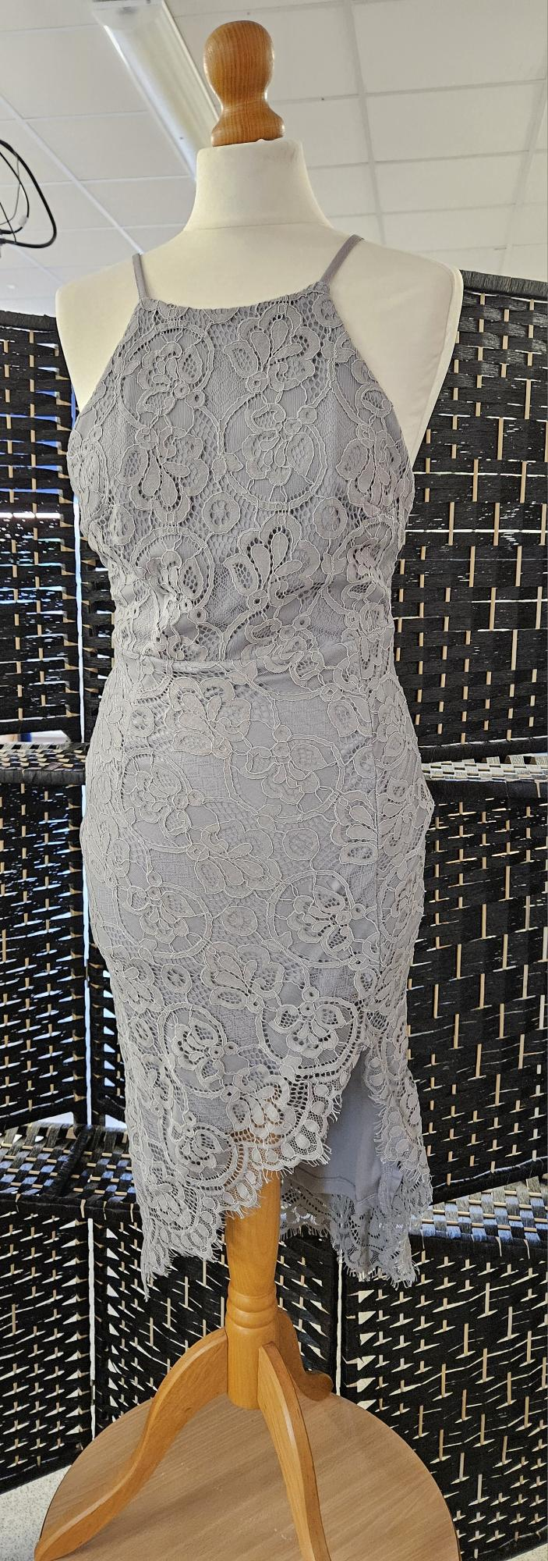
Grey, lace overlay
Size 10

Slide 12
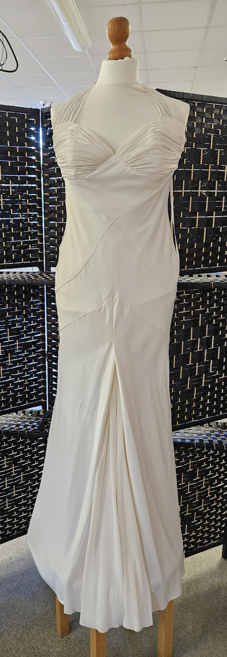
Cream satin, full length
Size 12

Slide 13
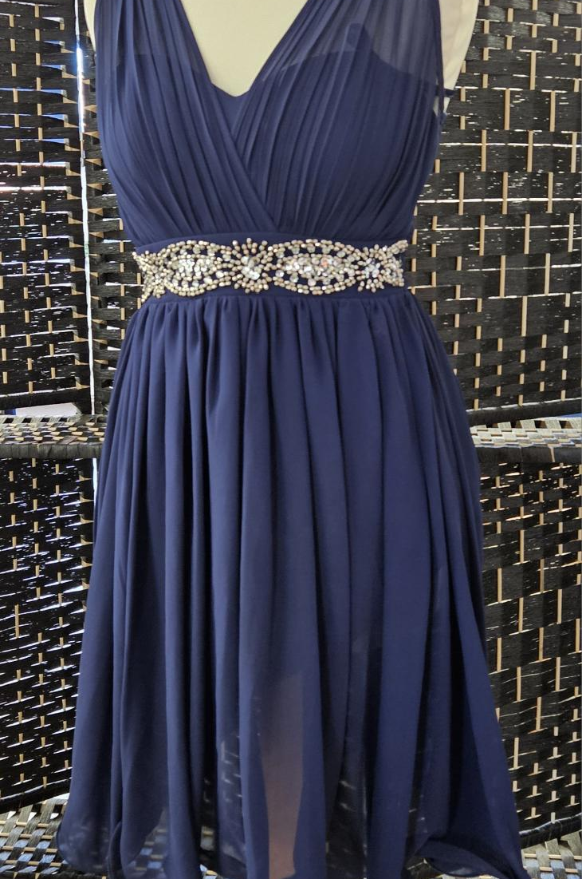
Quiz
Navy Blue, short dress, diamonte detail to waist.
Size 8

Slide 14
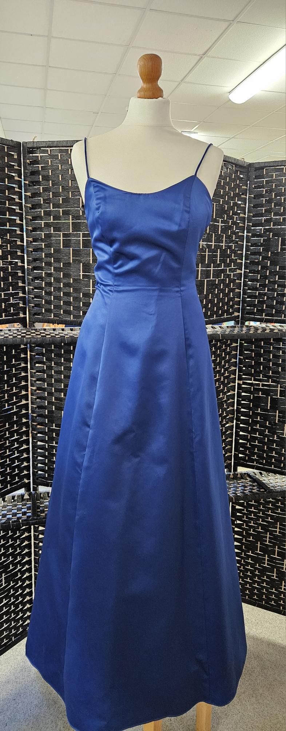
Morgan & Co
Navy Blue, A-line
Lace-Up back
Size 8/10

Slide 15
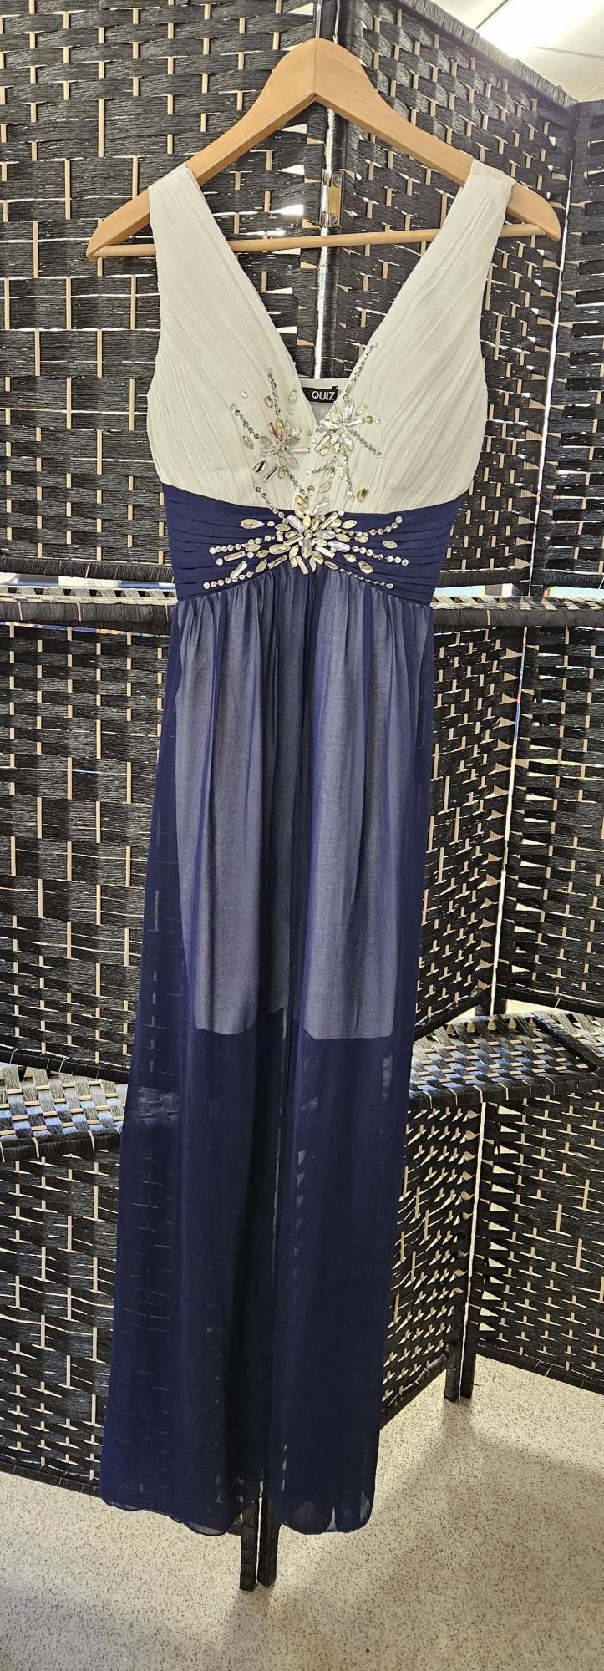
Quiz – Brand New with Tag
White with navy overlay
Size 8

Slide 16
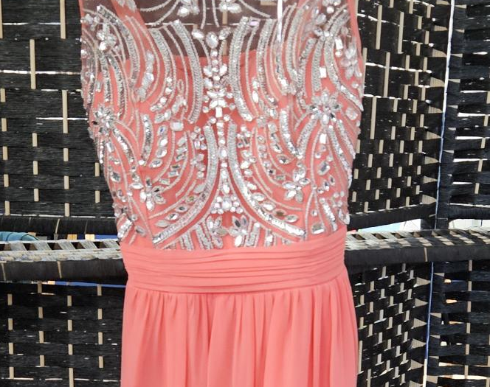
Quiz.
Coral, size 8
Full length

Slide 17
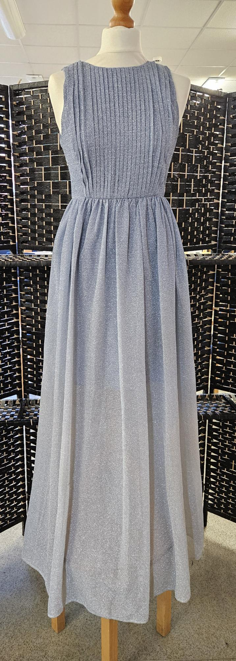
Chi Chi
Silver shimmer
Full length
Size 8

Slide 18
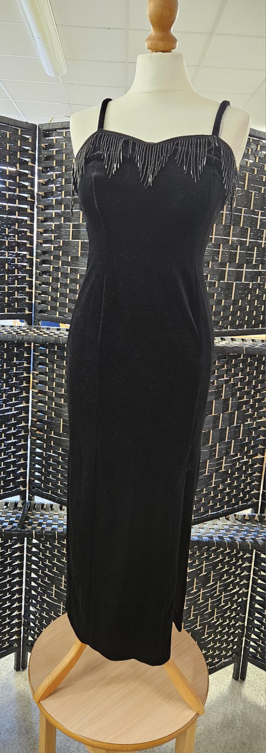
Black Crushed Velvet
¾ Length
Beading detail to neckline
Size 10

Slide 19
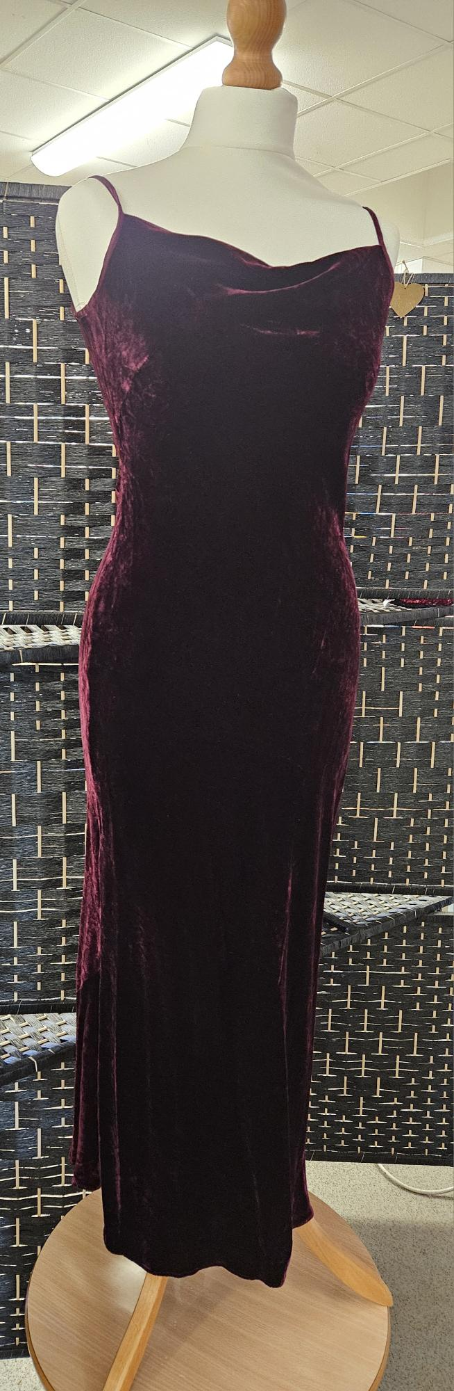
Next
Aubergine/Dark Purple
Crushed velvet, ¾ length
Size 8

Slide 20
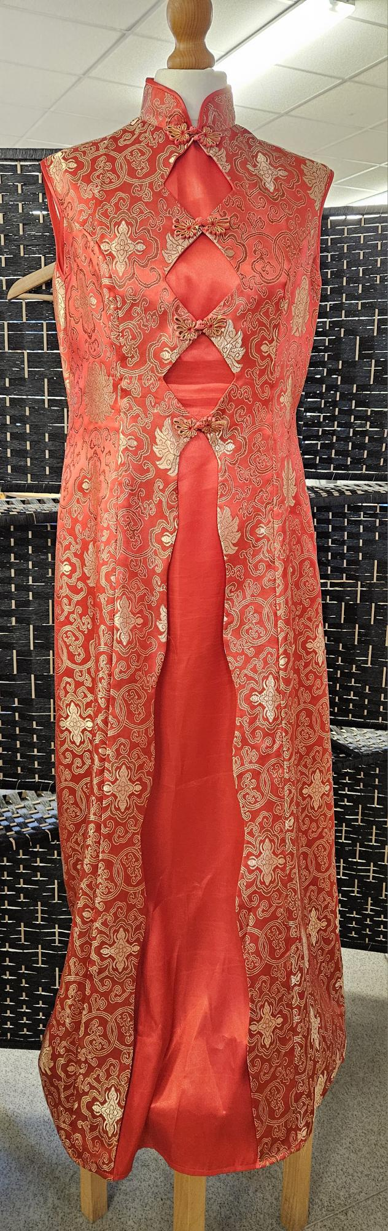
Oriental Style
Red with Gold embroidery
Size 14

