Slide 1
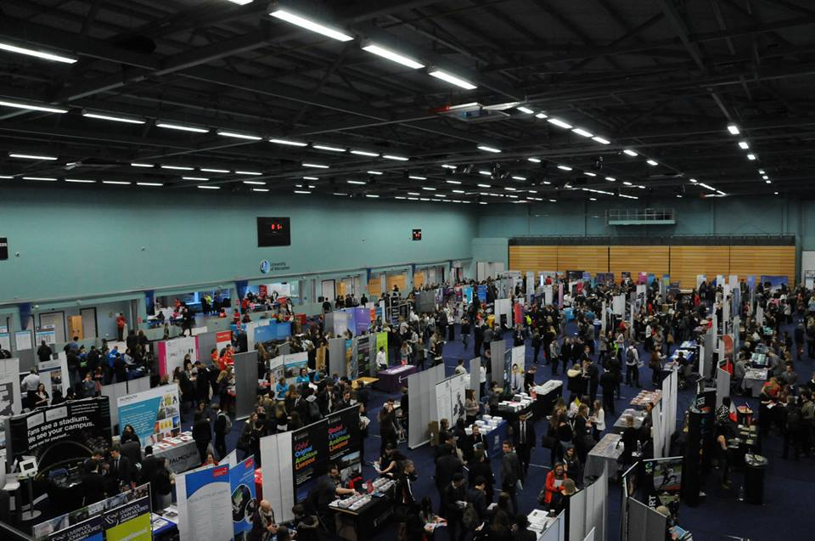
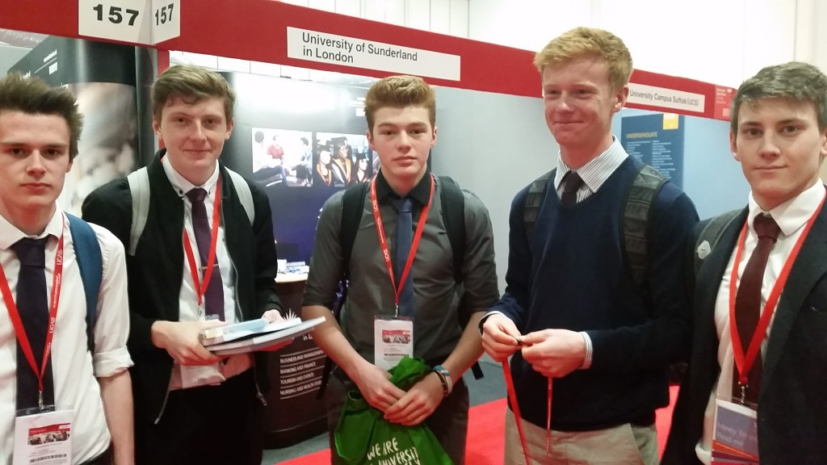
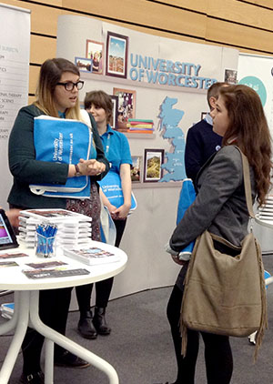


Futures
Y12 HE Day NEC Birmingham
Monday 20 June 2022

Slide 2
Housekeeping:
Non uniform and bring packed lunch.
Print off or download ticket to your phone or you will have delays getting in!
Meet playground 9:10 and line up in LM groups.
Buses leave at 09:30 and return to school by 3:00 in time for end of day.
Make sure you are at the meeting point for return PROMPTLY as we are not allowed to wait past our bus pick up time!
Stay on the bus you are allocated but free to move around in friendship groups at the venue.

Slide 3
HE Visit Preparation
Get your ticket using the information on the next slide.
Download the UCAS programme from the conventions page.
Go to the UCAS course search at https://digital.ucas.com/search and look at courses and universities that may be an option for you.

Slide 4
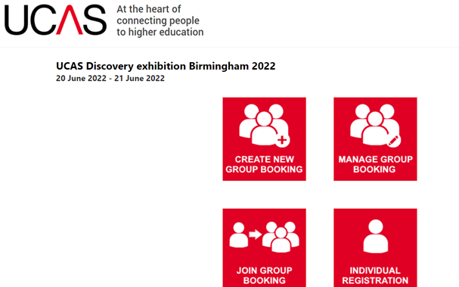
Ticket Download:
Go to www.ucas.com/exhibitions and find the event you are visiting. (Birmingham Higher Education Exhibition)
Click on “Book Now” button.
Click on the 'Join group booking', then 'I am a student'.
Enter the group booking reference UCASBKN625894 and click 'Find'. Your group booking details will be displayed.
Continue completing the form until you see confirmation that your booking has been processed. You will receive an email with a link to your personal ticket, which you'll need to either print or bring on your phone, to the event.

Slide 6

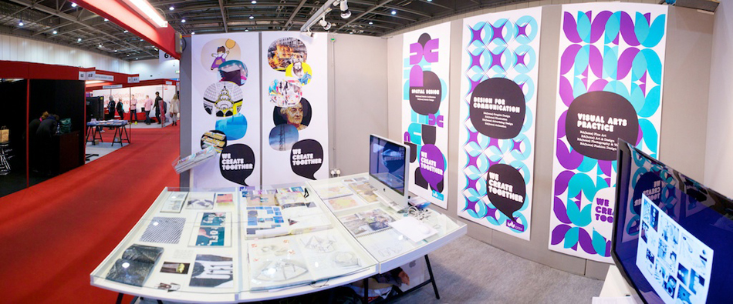
What’s There?
All the universities admissions advisers with student ambassadors and copies of prospectuses on their stand.
Apprenticeship, internship and employers in smaller numbers.
Student finance information.
Gap Year information stands.
Series of talks (see later slide).

Slide 7
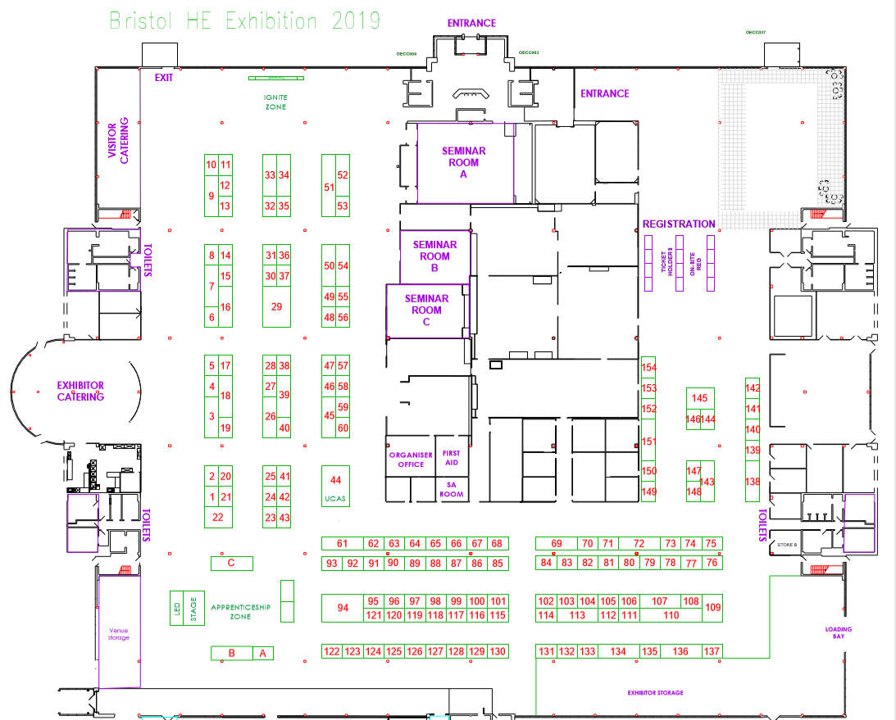

Slide 8
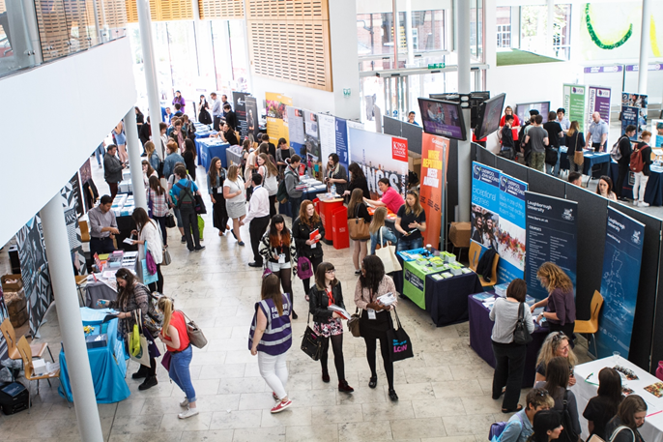
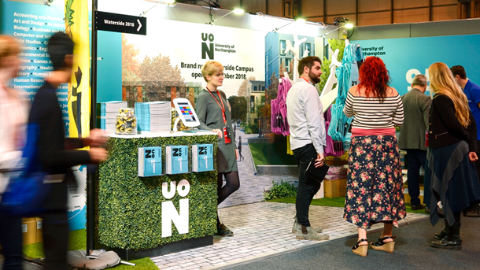
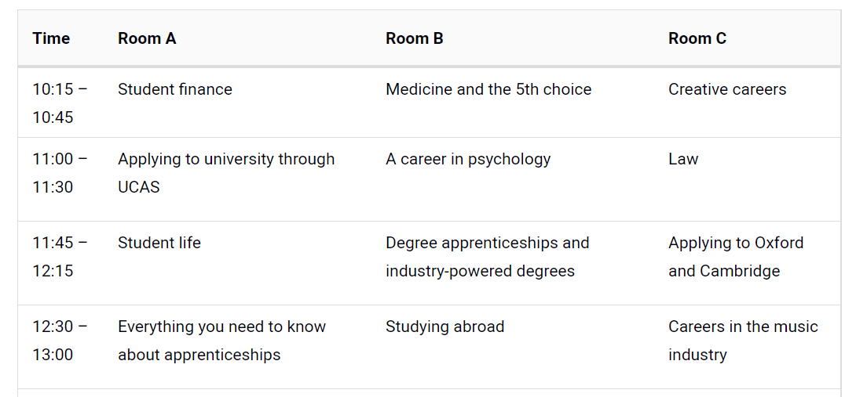
Talks/Seminars
Seminars will take place in the seminar rooms. Tickets are not needed but seats are on a first-come first-served basis.

Slide 9
Reminders on the day:
Meet in the playground at 9:10 promptly in LM groups.
Non uniform, packed lunch and pen and paper.
Remember to bring your ticket on your phone (with enough battery life!) or print a copy.
Ask loads of questions – you will never get all the providers together in one room again!
Scan the barcode at any of the stands to register your interest and they will email you with more information.
See how many freebies you can get from the stands as well as your copies of the prospectuses but remember they get heavy to carry round!
Go to at least one of the seminars (split between friends to cover as many as possible)
Meet at the identified area promptly at 1:15 for return to school and return on same coach to speed up boarding.

Slide 10

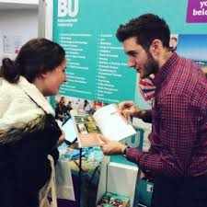
Preparation
Look at who is exhibiting and then identify who you want to see and their stand. Plan your route as it is busy!
Think about asking some of the following:
Is it campus or town-based?
Where is the course in relation to the main campus?
What are the entry requirements (subjects and grades/points)?
How is the course delivered and assessed?
Is there a placement year?
Can I do a combined degree or a 4 year master’s degree?
Do you offer a foundation year?
Are first year students guaranteed accommodation?
What types of accommodation/board are available?

