Slide 1







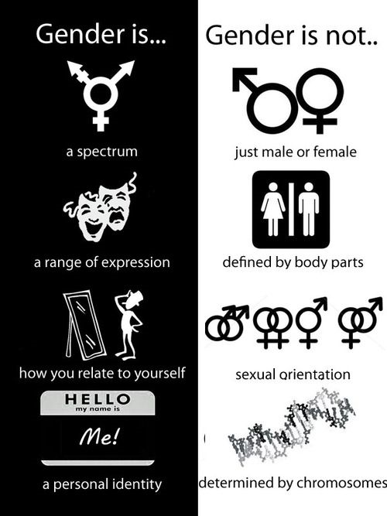
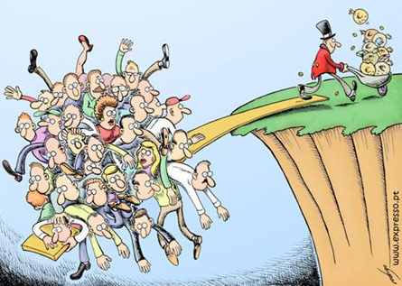



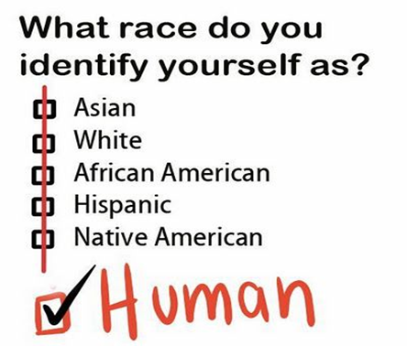


Introducing A Level Sociology
1
We follow the AQA A-level specification
If you have any questions over the summer email
sc@chosen-hill.gloucs.sch.uk

Slide 2

How is A Level Sociology Assessed?
2
Students sit exams at the end of Year 12 and Year 13. AQA Sociology A-level is a linear course without coursework. Year 12 helps you develop the key critical skills, thinking and social comprehension. Whereas as Year 13 allows you to practice these skills and complete your Sociological Imagination.
We focus particularly on how certain features of a person’s social position (i.e. their gender, social class and ethnicity) might affect their life chances in society.
Sociology is regarded as a Social Science, largely because it uses a number of research methods to examine society in more detail.
A major part of gaining success in Sociology is by learning the main ideas, concepts and terms used – the language of the subject – and then being able to use this language when you are discussing the topics and issues relevant to the study of society.
Paper One: | Paper Two: | Paper Three:
Education Methods in Context Theory and Methods - 33% of A Level | Families and Households Beliefs in Society - 33% of A Level | Crime and Deviance Theory and Methods - 33% of A Level

Slide 3
There are a lot of key terms that you need to know in Sociology. Lets start off with the basics:
Task 1: Define the following sociological key terms:
1. Norms
2. Values
3. Socialisation
4. Society
5. Culture
6. Identity
7. Social differentiation
8. Stratification
9. Status
10. Subculture
11.Cultural diversity
12. Consensus
13. Conflict
3

Slide 4

Have a go at the quiz to find out what type of Sociologist you may be?
5
What kind of Sociologist will you be?
1. The defining characteristic of human behaviour is:
A) Their gender/ sex
B) Their social class
C)Their Race
D) Their integration into society
E) Their culture
2. We have the freedom to choose our own behaviour
A) Yes
B) No
C) Depends
D) Doesn’t matter
E) What is freedom?
3. What are your views on the family….
A) Family is oppressive to women and teaches us to conform to gender roles
B) Family is a tool of the ruling class teaching us to obey authority
C) Family is a vital part of socialisation that teaches us norms and values
D) Family is what you make it, everyone has a different view on it
E) Family – what is a family? You can’t define it
4. When it comes to inequality
Gender is the most serious issue!
Money and power the rich exploit the poor!
Inequality is normal part of society
Inequality is a label that has different meanings to people
You make your own reality up
5. When it comes to Crime
The justice system is more lenient on women
Criminal laws protect the rich and powerful
Crime is good for society as it reminds us of the rules
Crimes are actions labelled as wrong to influence our behaviour
Crime – what is a crime? Can we really define what a crime is?
6. When it comes to religion
Religion oppresses and controls women – telling us to cover up and be obedient
Religion is a tool used by those with power to control us
Religion is a useful institution which unites people who share a common set of beliefs
Religion means different things to different people
Religion is just another meta-narrative (big story) people use to explain reality

Slide 5

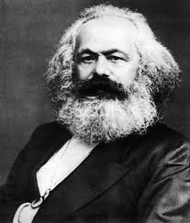
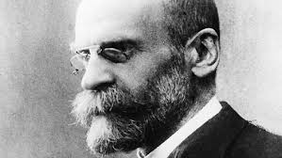

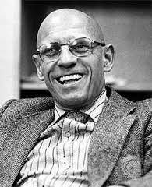
6
What kind of Sociologist will you be?
Mostly A – Our Feminist
You are most likely to turn into our Feminist Sue Sharpe. Feminism looks at how society is structured in a way that benefits men while oppressing women – this is known as patriarchy (male domination.). The theory is often a misunderstood as stereotypes and misconceptions about it exists. Many people do not realise that there are several types of feminism such as black, radical feminism and liberal.
Mostly B – Our Marxist
You are most likely to turn into Karl Marx. Marxism looks at how society is constructed is a way that produces class conflict with the rich having all the power and control whilst the poor are oppressed. Marx argues that the root cause of class inequality is down to capitalism as it encourages people to be greedy and materialistic. Just as capitalism replaced feudalism, Marx argues that capitalism will one day be replaced with communism
Mostly C- Our Functionalist
You are most likely to turn into Emile Durkheim. Functionalism is theory which argues that members of society are united together by a shared set of idea and beliefs called ‘norms’ (normal behaviour.) These norms are accepted by all members in society and are enforced by structures such as family and education. They see society like a human body – with all parts needed in order for it to ‘function’ and work effectively.
Mostly D- Our interactionist (Social Action Theory)
You are most likely to turn into Becker/ Mead. Interactionism looks at how people create meaning during social interactions, how they present and construct the self (or identity) as well as how they define situations. One of the perspectives key ideas is that people act the way they do because of how they define situations. Becker uses the example of nudity to illustrate how timing, place and audience can influence how people see an action or idea.
Mostly E – Our post-modernist
You are most likely to turn into Foucault. Post-modernism is a more recent Sociological theory which seeks to question and de-construct existing structures and understandings of reality. Post modernism rejects the idea that one theory such as functionalism, Utilitarianism, religion or even science can explain reality!

Slide 6
Structural Functionalism
Identify two significant structural functionalist theorists.
Functionalism is a ‘consensus theory’ what does this mean?
Functionalists argue for an ‘organic analogy’ view of society. What does this mean? Give examples to illustrate your understanding.
How is social order maintained for functionalists?
Where do norms and values come from according to functionalists?
Functionalists believe that society is open and fair and that capitalism is based on a ‘meritocracy’, what does this mean?
Functionalism is said to be a conservative theory, what does this mean? (I am not talking about the Conservative Party)

Slide 7
Structural Marxism
Who created the Marxist view of society?
What is the base/superstructure of society? Give an example to illustrate your understanding.
Marxism is a conflict theory, what does this mean?
How many classes are there in a capitalist society according to Karl Marx? Who are they?
How do the concepts of norms and values link to the concept of ‘dominant ideology’?
How do marxists hope to bring about an end to capitalism?
Marxism is said to be a radical theory, what does this mean?

Slide 8
Feminist Theory
Who is considered to be the first feminist and what was her book called?
Feminism is a conflict theory, who is in conflict?
How many types of feminist theories are there?
What is patriarchy? Give examples to illustrate your understanding.
Firestone argued for the separation of men and women, how did she hope to achieve this?
Which type of feminist believes that women/s lives can be improved through changes in the law?

Slide 9
Social Action Theories
What are the main focus of social action theories?
Who is considered to be the founder of social action theory?
Where do social action theorists view the source of our behaviour coming from?
Social action theories are ‘micro’ in their approach, what does this mean?
Social action theorists believe that the world is a subjective creation, what does this mean? Give an example to illustrate your understanding.
For your first lesson we expect you to have the following:
Folder labelled with your name on and Sociology.
There must be dividers in your folder – plastic ones are better as they are tougher.
Your own lined paper and plenty of plastic wallets.
A pencil case with the usual in it - but we use a lot of post-it notes and highlighters so have plenty of those.
Well done! You’re all set ready to embark on your Sociology A Level course. We look forward to seeing you in September!

Slide 10
Postmodernism
How is society characterised by postmodernists?
Postmodernists argue that we cannot make generalisations about human behaviour as the overarching groups we used to belong to collectively are now dead. Identify one of these groups.
What are metanarratives and why do postmodernists argue that they are useless for looking at society?
Postmodernists argue that we have more choices then we have ever had in our lives. Identify two.
For your first lesson we expect you to have the following:
Folder labelled with your name on and Sociology.
There must be dividers in your folder – plastic ones are better as they are tougher.
Your own lined paper and plenty of plastic wallets.
A pencil case with the usual in it - but we use a lot of post-it notes and highlighters so have plenty of those.
Well done! You’re all set ready to embark on your Sociology A Level course. We look forward to seeing you in September!

