Slide 1
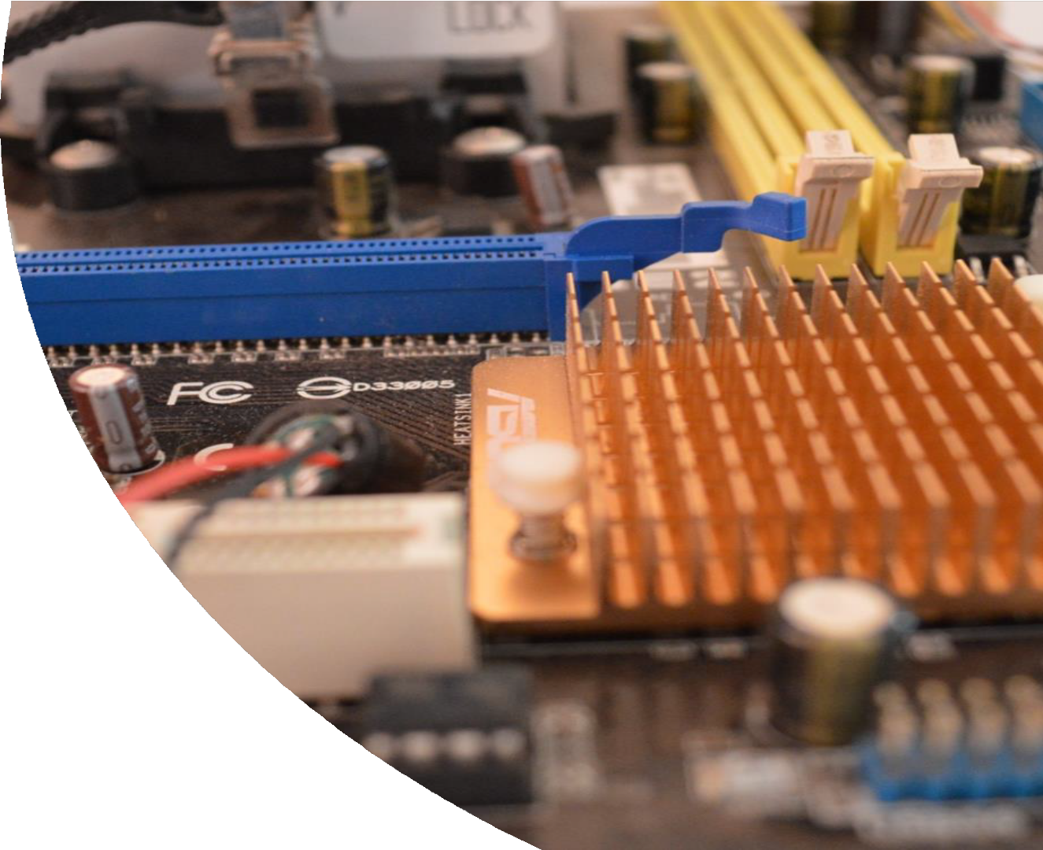

Computer Science Transition workbook
GCSE to A level
The course is assessed by 2 exams (40% each exam)
&
1 NEA (programming project (20%)
The topic of Computer Science is at the heart of the modern world
Studying it can make you extremely sought after in todays job market
The transition from GCSE to A level is significant, this includes:
  An increased emphasis on technical content
  An increased emphasis independent research
This workbook is designed to allow you to practice some of these skills and build on your existing knowledge. Each slide has a number in the top left to indicate the exercise number. Ensure you keep your work safe.
Please complete by your first lesson back in September. Bring to your first lesson.

Slide 2
Compulsory - Independent research task
1
Emerging computer technology
Expected time to complete: 2 hours
In this task you get to investigate any area of emerging computer technology which interests you.
You can pick any area which interests you, but examples could be:
Artificial intelligence
Robotics
Automated self driving cards
Quantum computing
In no more than ONE side of A4 summarise the area you have chosen under the following four headings:
What is it?
What are the possible Social, Moral, Cultural and Ethical benefits of this technology on society
What are the possible Social, Moral, Cultural and Ethical risks of this technology on society
My conclusion on this technology and what it will mean for our world 10 years from now
Additional help:
For additional help and support in structuring your answer you might like to watch some of the videos from the following Craig ‘n’ Dave playlists:
OCR:
SLR 17 – Ethical, morale and cultural issues https://www.youtube.com/watch?v=4h5zlBOgZz0&list=PLCiOXwirraUBrBvmXkcwEYki7YOOkCgjC#

Slide 3
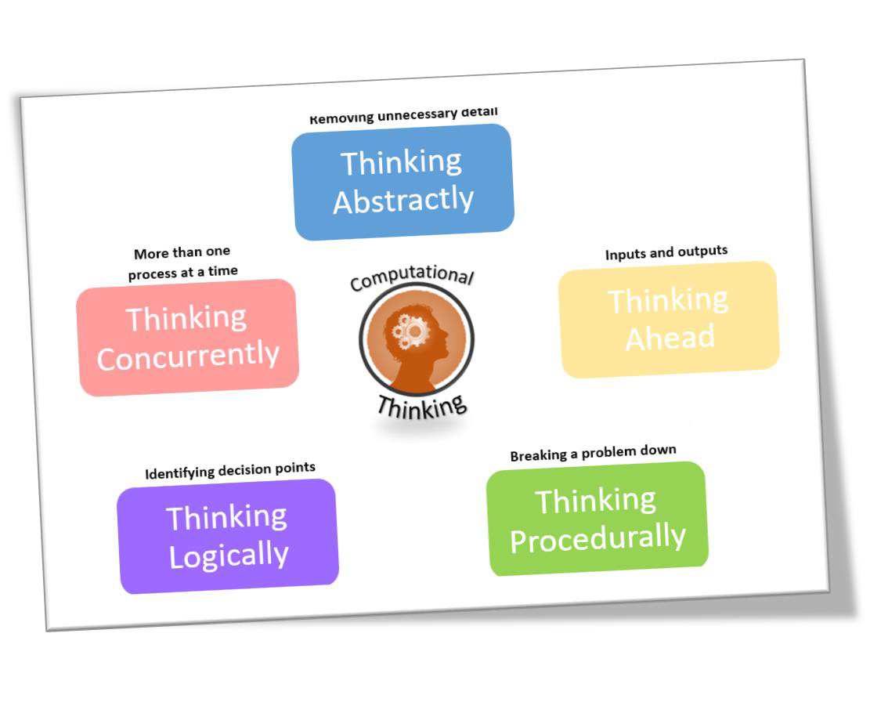
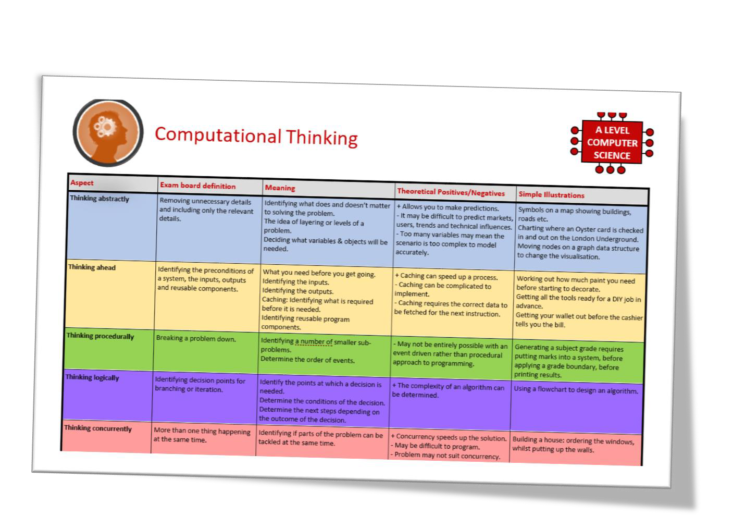
Compulsory - What is “computational thinking”?
2
Thinking like a computer
Expected time to complete: 2 hours
At the heart of Computer Science is the ability to look at problems, analyse them, break them down and
solve them in a way which involves a variety of “Computational Thinking” skills.
Download the “Computational thinking and Computational methods placemats” from Craig n Dave:
  https://student.craigndave.org/specification-key-terminology-and-cheat-sheets
Create your own spider diagram / mind map which shows your clear understanding of the 5 different computational thinking strands
  Keep it to a single side of A4 / A3
Your goal is to imagine someone else has to revise from your mind map. Ask yourself:
  Does it make sense?
  Is it clear?
  Does it cover all of the important concepts?

Slide 4
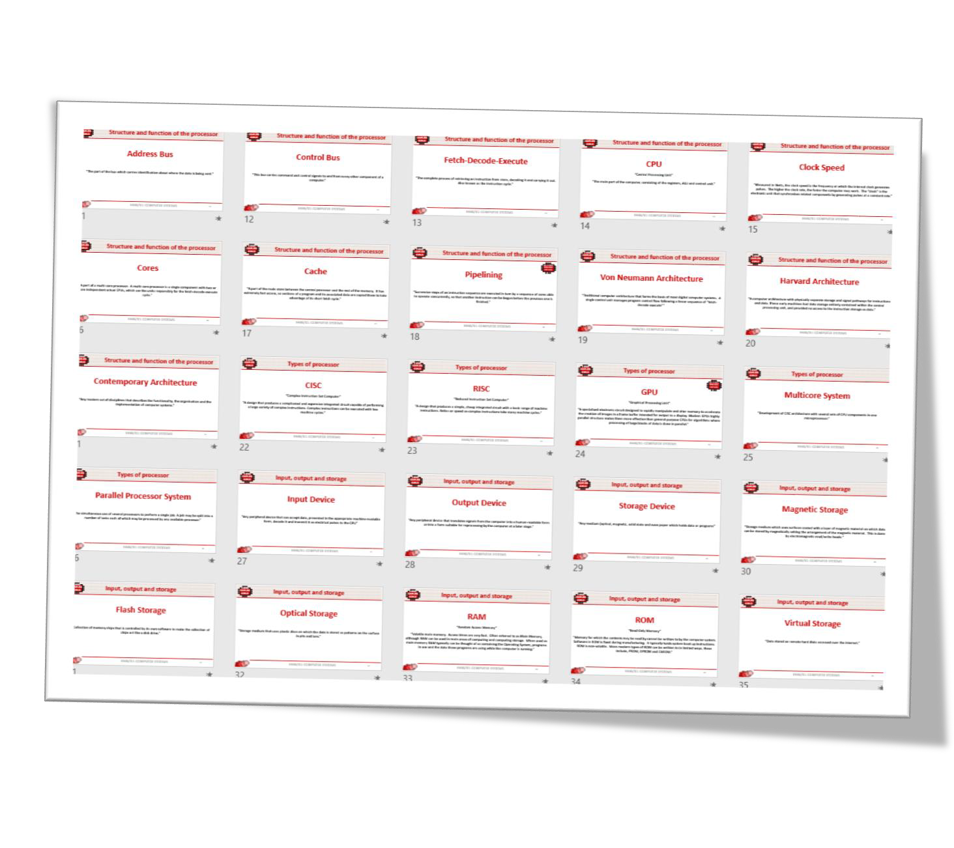
Optional - Key terms task
4
Getting to grips with terminology
Expected time to complete: 2 hours
An important aspect of being successful with your study of Computer Science is getting to grips with subject related terminology. There are over 240 specific terms you will need to learn!
Below are a handful of the key terms you will need to become familiar with.
Control Unit | Register | Busses
Von Neuman Architecture | Optical Storage | Operating System
Intermediate Code | Device Driver | Compiler
Assembly Language | Machine Code | Lossy Compression
Hashing | Normalisation | TCP/IP Stack
Packet Switching | ASCII | Problem Decomposition
Research each of the key terms and write a definition.
Resist the urge to simply cut and paste a definition from the first website you find. Many definitions found on The Internet are overly complicated and wordy.
Ask yourself:
  Does my definition make sense?
  Is it succinct, to the point?
  Does the definition have appropriate depth and detail for A’Level?
  Could I give this definition to another student so they could revise from it?

Slide 5
Optional - Programming tasks
5
In A-Level Computer Science we will be studying a variety of programming languages other than just Python.
You can use one of the following languages but this list is not exhaustive:
C family of languages (for example C# C+ etc.)
Java
Unity game engine
Visual Basic PHP
Delphi
JavaScript
Python
Use YouTube video tutorials to start learning, there are plenty of online tutorials for all of these languages
HINT: You will probably first need to download and install an IDE for your chosen language.

