Slide 1
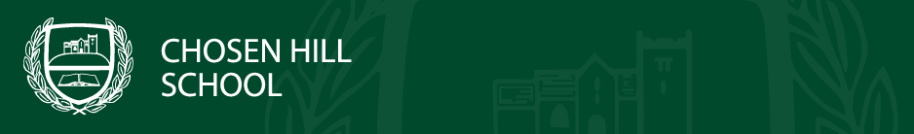


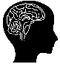




Wellbeing, Relationship and Social Education
 | Relationships and Sex Education |  | Physical Health and Wellbeing |  |  | Mental Health and Wellbeing |  | Financial Literacy and Careers |  | Citizenship and Political Literacy
Personal Safety:
Drugs, alcohol, misinformation, safety and first aid
The Serious Side of Sex:
Pregnancy, pregnancy options, contraception, menopause
Communication is Key:
Sexual harassment, consent, pornography, ideology
Next Steps:
Skills, careers and finances
Year 11
Building for the Future:
Skills, careers and finances
Healthy Relationships:
Relationship types, managing conflict, coercive control and criminal justice system
Managing my Mental Health:
Learning resilience techniques to understand and manage mental health
Understanding Politics
The British Political System, how it works, the UKs place in the world, your voice and protesting
Year 10
The Ethics of Sex 2:
Healthy relationships, contraception and STIs
The Ethics of Sex 1:
Healthy relationships, consent, forced marriage and pornography
Lesson from Gloucestershire Police PC Murphy:
Anti-Social Behaviour and Stop and Search
My Amazing Teenage Brain:
How to look after and develop your teenage brain
Lesson from Gloucestershire Police PC Murphy:
Exploitation
Year 9
Being Streetwise Online:
Living a Safe Life Online
My Mind and Me:
Mental Health and Resilience
# Love Me:
Body Image, appearance, eating disorders, masculinity
Making Good Choices: Antisocial behaviour, knife crime, alcohol, vaping
Drugs, the Law and my Choices:
Legal and illegal drugs and the Law around them
Respectful Relationships:
Good or bad relationships and managing conflict
Year 8
My Health:
Diet, Sleep and Being Healthy
The Real Game:
The Life Dream and Paying for it
My Teenage Body and Me:
Puberty and reproduction
Year 7
Diversity, Prejudice and Bullying:
Respect, Diversity & Protected Characteristics
Lesson from Gloucestershire Police PC Murphy:
Grooming
Who am I?
Identity and Different Relationships
You are Awesome:
Growth vs Fixed Mindset

