Slide 1













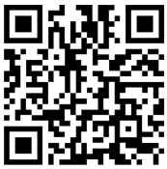















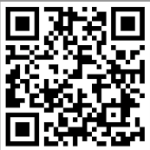






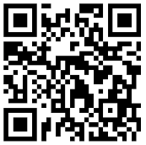

Spanish
A Level Exams Show the world what you can do!
Diversity and Difference
Film and Literature
Year 13 A Level
Graduate and
SAVE THE WORLD!
The two Spains: 1936 onwards
Understanding the Spanish Speaking World
Global Sustainability
Home and Locality
Year 12 A Level
Spain and Spanish Speaking Countries
GCSE Exams
Show the world what you can do!
Being a Young Person in Spanish-Speaking Society
Year 11 GCSE
World of Work
Youth Culture
Customs and Traditions
Jobs and Future Plans
Current Study
Lifestyle
My Holidays
Year 10 GCSE
My Free Time
Year 9
My Area and the Environment
My Studies
Who am I?
Year 8
Year 7
My Family and Friends

