Slide 1

















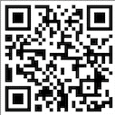
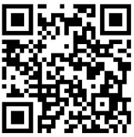
German
German is offered as an additional language to students of French and Spanish from Year 8​
A Level Exams Show the world what you can do!
Diversity and Difference
Film and Literature
Year 13 A Level
Graduate and
SAVE THE WORLD!
The making of modern Germany: 1989 onwards
Understanding the German Speaking World
Global Sustainability
Home and Locality
Year 12 A Level
Germany and German Speaking Countries
GCSE Exams
Show the world what you can do!
Being a Young Person in German-Speaking Society
Year 11 GCSE
World of Work
Youth Culture
Customs an Traditions
d
Jobs and Future Plans
Current Study
Lifestyle
My Studies
My Free Time
Year 10 GCSE
Year 9
My Family and Friends
Who am I?
Year 8
Year 8

