Slide 1




























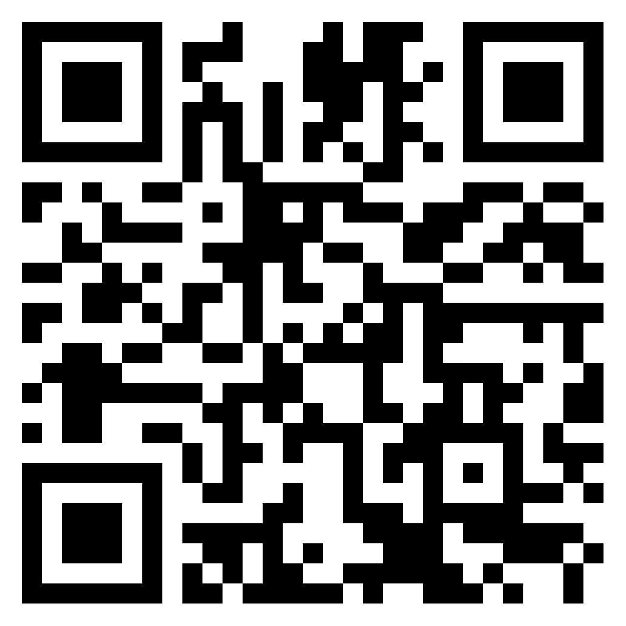






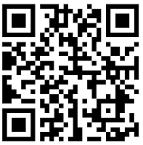

French
A Level Exams Show the world what you can do!
Diversity and Difference
Film and Literature
Year 13 A Level
Graduate and
SAVE THE WORLD!
France 1940-1950: The Occupation and Post War Years
Understanding the French Speaking World
Global Sustainability
Home and Locality
Year 12 A Level
France and French Speaking Countries
GCSE Exams
Show the world what you can do!
Being a Young Person in French-Speaking Society
Year 11 GCSE
World of Work
Youth Culture
Jobs and Future Plans
Current Study
Lifestyle
My Holidays
Year 10 GCSE
Customs and Traditions
My Area and the Environment
Year 9
My Free Time
My Studies
Who am I?
Year 8
Year 8
Year 7
My Family and Friends

